Slide 1

Improving Motivational Interviewing Skills in Community Corrections
Karen Ingersoll
University of Virginia
http://ingersolltraining.com
Presented to Virginia Community Criminal Justice Association
Nov. 14, 2012
Williamsburg, VA

Slide 2

Background
MI has been recommended as an Evidence Based Practice for corrections settings
Many corrections professionals came from law enforcement, were not trained as counselors, but are in a quasi-counselor role
Community corrections agencies must blend MI with other approaches to minimize harm to the community and maximize help to the offender

Slide 3
What is MI?
Motivational Interviewing (Miller & Rollnick, 1991, 2002, 2013) is:
  A Client-Centered, Directive Counseling Style to Facilitate Behavior Change
An evidence-based approach with over 200 Randomized Clinical Trials, soon to be registered with NREPP as an Evidence Based Practice to address substance abuse
Applies to diverse target behaviors
  Drug use
  Drinking
  Criminal behaviors
  Medication adherence
  Water purification
  Diet and exercise adherence

Slide 4
Objectives for Today
At the end of this presentation, you will be able to:
Describe how persuasion “feels” different from MI
Discuss the 4 Processes of MI
Understand the Spirit and key techniques of MI
Use a simple script to approach your clients with a need to consider behavior change
Discuss the long-term experience of Implementing MI in a Virginia Community Corrections Setting

Slide 5
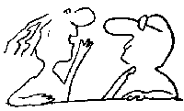
Let’s Practice!
Get into pairs, even if it mean switching seats
You and your partner will each get a turn to try persuasive and MI techniques

Slide 6
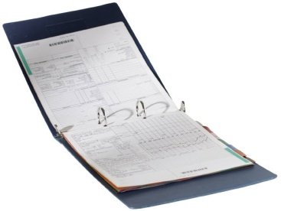
Your challenge
The Situation. You are a busy occupational health nurse.
You conduct health screenings for employees.
You are feeding back the results of a health screen to an employee.
You only have about 10 minutes for your first discussion with this person.
The Patient.
This person is clearly overweight, also smokes, and drinks about 6 beers a night.
Both blood pressure and cholesterol are elevated, and you are very concerned about this person's diet and weight.
The employee is married, has 3 children, and has been working with the firm for 15 years.

Slide 7
Your Task
Try as hard as you can to persuade this person to do something about his or her diet, smoking, or drinking. This is a serious matter, and you do not have a lot of time. It's not your job to be a "therapist"; rather, you are paid to be a competent, concerned, and forthright health practitioner.

Slide 8

Persuading to Change
1. Using the health information you have, explain what the person should change and why the person should make this change.
2. Give three specific benefits that would result from making the change.
3. Tell the person how to change.
4. Emphasize why change is important. This might include the negative consequences of not doing it.
5. Tell/persuade the person to do it.
If you encounter resistance, repeat the above, perhaps more emphatically.

Slide 9

Motivational Interviewing (MI)
A counseling style that explores and resolves normative ambivalence about change
A method that builds the person’s own motivation for change
A quiet style that gradually evokes change
An evidence based practice that reduces strain on clinicians while guiding patients to take responsibility and make decisions that benefit their health and their lives
An approach that relies on eliciting rather than providing

Slide 10
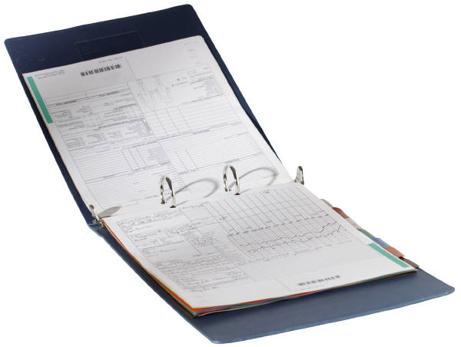
Your challenge
The Situation. You are a busy occupational health nurse.
You conduct health screenings for employees.
You are feeding back the results of a health screen to an employee.
You only have about 10 minutes for your first discussion with this person.
The Patient.
This person is clearly overweight, also smokes, and drinks about 6 beers a night.
Both blood pressure and cholesterol are elevated, and you are very concerned about this person's diet and weight.
The employee is married, has 3 children, and has been working with the firm for 15 years.

Slide 11

Try it the MI Way
What concerns you most about your health?
What, if anything, might you want to change?
Why would you want to make this change?
What are the 3 best reasons for you to do it?
How is it for you to make this change, on a scale from 0 to 10,where 0 is not at all important, and 10 is extremely important? [Optional followimportant-up question: And what makes it a _____ rather than a 0?]
If you decide to make this change, how might you go about it in order to succeed?
After you have listened carefully to the answers to these questions, give back a short summary of what you heard, of the person’s motivations for change. Then ask one more question:
So what do you think you’ll do? and listen with interest to the answer.

Slide 12
Debrief
Which way felt better to you as a client?
Which way felt better to you as a worker?
Which way felt more natural?
Which way seems more likely to lead to genuine, maintained change?

Slide 13
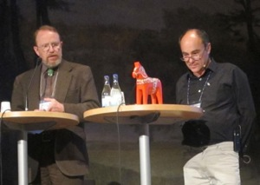
A few facts on MI
First described in 1983 by Bill Miller Ph.D.
Books on MI by Miller and Steve Rollnick in 1991 and 2002; new edition of Motivational Interviewing (2013) NOW
Multiple books available on applications of MI
Second only to Cognitive behavioral therapy in number of research studies and publications

Slide 14
Efficacy of MI
Equal to other active evidence based treatments but briefer
Multiple meta-analyses and syntheses of studies find a small to moderate effect size across problem behaviors, cultures, patient populations, and target behaviors
Active research on mechanisms of change

Slide 15

Lesser known facts about MI
Not theoretically based
Pragmatic, clinically-based
evolving development

Slide 16
MI is not a
Behavioral Therapy
It targets behavior but not through providing
  Models
  Solutions
  Skills
  Information
It is a client-centered or patient-centered approach at its heart
Wagner and Ingersoll (in press) in Hayes et al., Acceptance, Mindfulness, Values, and Addictive Behaviors: Counseling with Contemporary Cognitive Behavioral Therapies. New Harbinger Press

Slide 17
Spirit of MI
Partnership
Compassion
Evocation
Acceptance
Miller & Rollnick, 2013

Slide 18
Acceptance
Partnership
Compassion
Evocation
Acceptance
MI Spirit
Affirmation
Autonomy Support
Accurate Empathy
Absolute Worth
Miller & Rollnick, 2013

Slide 19
Four Processes of MI
Engage
Focus
Evoke
Plan
Miller & Rollnick 2013

Slide 20
Four Processes of MI
Engage
Focus
Evoke
Plan
Miller & Rollnick 2013

Slide 21
Engage
To establish a helpful connection
To build rapport
To offer relationship
Open Questions
Affirmations
Reflections
Summaries
Fundamental MI Client-centered Skills

Slide 22
Let’s Practice!
Dyads: partner up again!
Client: think of something you are considering changing, but haven’t yet
Counselor, use OARS to engage in the following sequence:
  Tell me about something you are considering changing.
  Affirm the person’s thoughts, actions, or feelings about the change so far
  Tell me more.
  Reflect what you hear
  Summarize the main points

Slide 23
Four Processes of MI
Engage
Focus
Evoke
Plan
Miller & Rollnick, 2013

Slide 24
Focus
To develop a specific agenda
To develop change goals
To add direction
Open Questions
Affirmations
Reflections
Summaries

Slide 25
Focus
To develop a specific agenda
To develop change goals
To add direction
Open Questions
Affirmations
Reflections
Summaries
Explore
Exploring Values
Exploring Perspectives
Envision
A Different Way
A Different Outcome

Slide 26
Let’s Practice!
Dyads: partner up again!
Client: same issue you are considering changing, but haven’t yet
Counselor, use OARS to engage in the following sequence:
  Tell me about one part you are most interested in changing now.
  Affirm the person’s thoughts, actions, or feelings about the change so far
  Tell me more/explore values related to the one part.
  Reflect what you hear
  How would things be different once you’ve made this change? What would life look like then?
  Summarize the main points

Slide 27
Four Processes of MI
Engage
Focus
Evoke
Plan
Miller & Rollnick, 2013

Slide 28
Evoke
Find the person’s motivation for specific change
Respond to change talk
Elicit the person’s rationale for and strategies for changing
Elaboration
Use Evocative Questions
Use scaling Rulers
Reflect
Ask Key Questions

Slide 29
Evoking Strategies
Elaboration
Tell me about why this change would be good for you.
Evocative Questions
What makes this change important to you?
What might happen if you don’t make this change?
Scaling Rulers
On a 0-10 scale, with 0 being not important at all, and 10 being extremely important, how important is it for you to make this change now? What makes is an x and not a 0?
On a 0-10 scale, with 0 being not confident at all, and 10 being extremely confident, how confident are you to make this change now? What makes it an X and not a 0?

Slide 30
Evoking Techniques
Reflect
You think…
You feel…
Key Questions
What’s the next step?
Where does this leave you?
You are…
What do you make of this?

Slide 31
Let’s Practice Evoking!
Dyads: partner up again!
Client: same issue you are considering changing, but haven’t yet
Counselor, use Evoking Strategies and Techniques to engage in the following sequence:
  Tell me about why this change would be good for you.
  Reflect what you hear
  What makes this change important to you? What might happen if you don’t change?
  Reflect the person’s motivations, and vision
  Ask: Where does this leave you? What’s the next step?

Slide 32
Four Processes of MI
Engage
Focus
Evoke
Plan
Miller & Rollnick 2013

Slide 33
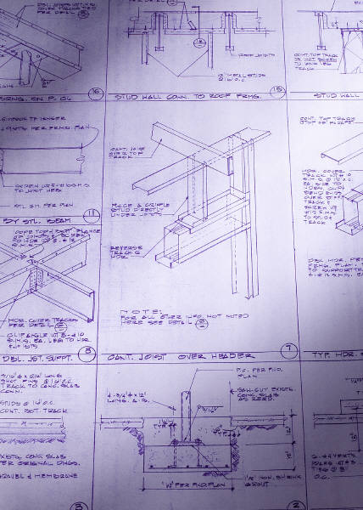
Plan
Optional! NOT always a part of MI
Help develop plan
  For self change
  For supported change

Slide 34
Planning
What is the change you want to make?
What are the important reasons to make this change now?
What might get in the way?
Who could help you?
What’s the first step?
How will you know the plan is working?

Slide 35
Let’s Practice Planning!
Dyads: partner up again!
Client: same issue you are considering changing, but haven’t yet
Counselor, ask these open questions in the following sequence, reflecting what you hear each time:
  What is the change you want to make?
  What are the important reasons to change now?
  What might get in the way?
  Who could help you?
  What’s the first step? When will you start?
  How will you know the plan is working?

Slide 36

Building MI skills
Most clinicians master 8 tasks as they learn MI
  Collaborative attitude/open mind
  Staying with the spirit of MI: Partnership, Acceptance, Compassion, Evocation
  Mastering OARS
  Developing broad client-centered counseling skills
  Recognizing change talk
  Eliciting the client’s own solutions
  Consolidating commitment to change
  Blending MI with other skills

Slide 37
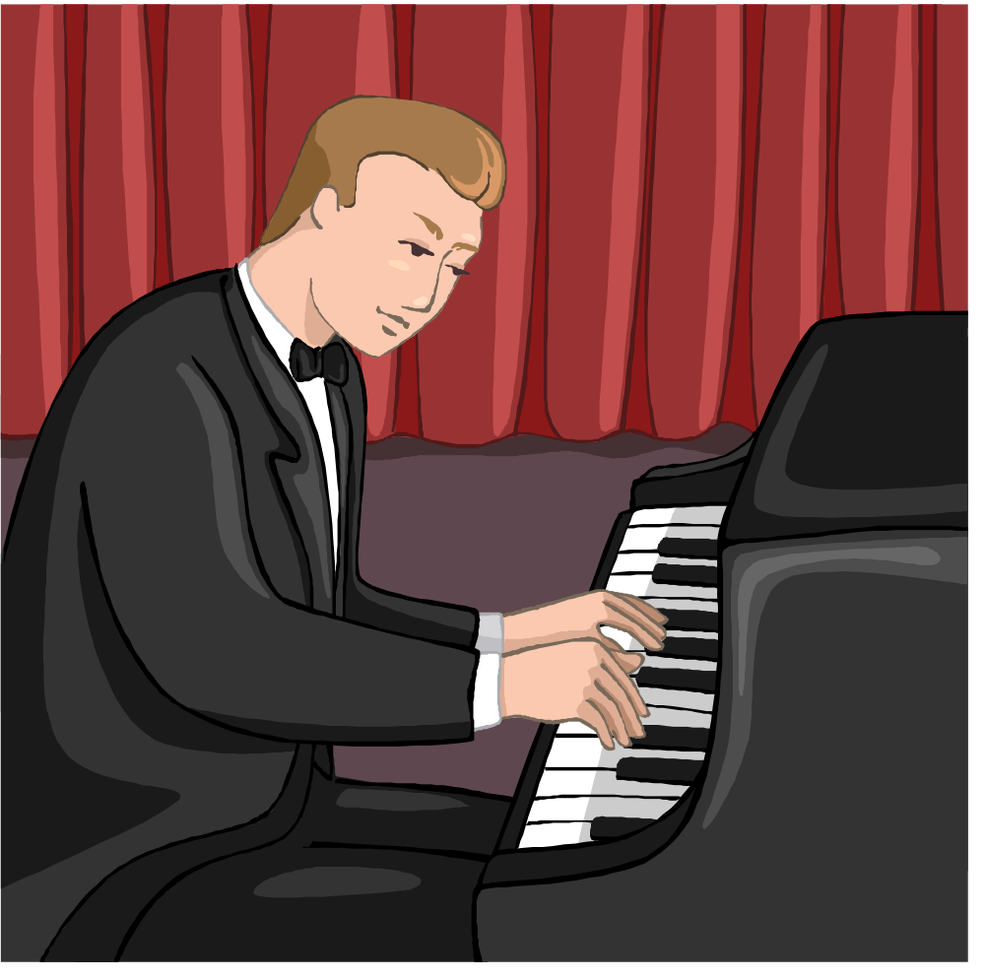
MI takes time and PRACTICE to learn

Slide 38
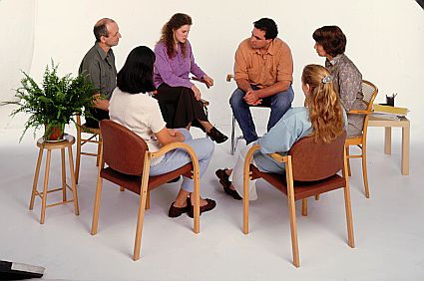
Is a peer coaching model feasible and effective to help community corrections staff learn MI?
Aims were to:
Facilitate the integration of Motivational Interviewing (MI) into a community corrections agency by coaching peer leaders to train groups of staff in MI
Document skills in MI over time using objective measures

Slide 39

Goals
Build agency skill in Motivational Interviewing
Near-term: to help peer leaders facilitate useful group learning sessions on Motivational Interviewing
Longer-term: to help agency demonstrate its implementation of an evidence-based practice through objective coding of real work samples

Slide 40
The Setting
A non-profit organization that serves Pre-trial, Probation, Re-entry, Drug Court, and Restorative Justice clients
Includes 24-27 managers, supervisors, clinicians, case managers with diverse training
Agency is a state model program in applying Evidence Based Practices
Agency staff members receive training in Effective Communication Skills and Stages of Change upon hiring.
MI was selected as an evidence-based practice for the agency in 2009

Slide 41

Strategies
Coach peer leaders to lead staff groups that foster learning MI
Advise about new developments in MI, learning MI, and applying MI in corrections
Guide the agency in selecting appropriate measurements to capture MI skills
Build MI strength across agency services
Other technical assistance as needed

Slide 42
A Parallel Process Approach to Training Peer Leaders
Over 29 months, 6 peer leaders worked with an MI trainer to develop skills in training MI
The group met monthly for 90 minutes to review topics drawn from eight stages of learning MI, with demonstrations of training MI constructs
Peer leaders’ group reviewed exercises and content for their subsequent groups
The process built up a “catalog” of teaching tools

Slide 43
Training Curriculum
Content based on:
MI trainer selection
Peer leader requests
Evolving agency needs
Process based on:
MI trainer suggestions
Peer leader and supervisor guidance

Slide 44
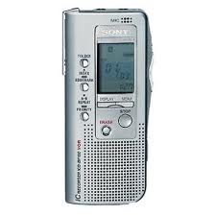
Peer Leaders’ Approach to Training Staff
Peer leaders trained 7-8 staff members in small groups in co-trainer pairs 10 months each year
After a year, the peer leaders taped practice samples that were rated by outside coders using the Motivational Interviewing Treatment Integrity (MITI) code
They shared their tapes and ratings with their small groups to encourage staff members to record their own practice samples

Slide 45
Peer Leader Topics:
Year 1
Agenda setting
Current MI activities, giving feedback, fixit mentality, empathy test
Introducing MI spirit
Stages of change, role plays, interpersonal concepts
Starting off right in a group, 8 stages of learning MI
MI vs. Effective communication
Persuasion, readiness, summary and key questions exercises
Evoking vs. Installing, Righting Reflex, and Ambivalence
Recipe/sports skills metaphors for MI practitioner

Slide 46
Results: Year 1
5 peer leaders remained with the project
All 24 staff members submitted at least 2 tapes for coding
All Peer leaders demonstrated strong MI skills on MITI global ratings
18 of 24 staff demonstrated beginning competence in MI on global scores, achieving a 4/5 on MI Spirit, Empathy, and Direction
The 6 who did not achieve competence in MI global scores during Year 1 failed due to low MI spirit, with 2 also demonstrating low Empathy

Slide 47
Year 2 Process
Groups were re-formed by program area
Peer led groups of staff continued with repetition of topics using novel exercises
1 new Peer Leader was selected by existing Peer Leaders and assisted leading one of the groups
3 tape samples were required of all staff members and MI results (Pass/Fail) were included in Performance Evaluation

Slide 48
Peer Leader Topics:
Year 2
3 Chairs to Practice Detecting resistance, detecting change talk
Plans for taping practice, drumming for change talk
Overview of MITI coding
Taping debrief, using the OARS reel to consolidate skills
Peer leader feedback, First set of staff tapes due, conversational strategies
Review of coding results and feedback process
Where clinicians get stuck, Second set of staff tapes due
Applying MI skills in performance evaluation
Curriculum review, considerations of different levels of MI training/coaching
3rd set of staff tapes due before Staff Yearly Performance Review

Slide 49
Results: Year 2
4 peer leaders remained with the project and a new one was added
All peer leaders maintained strong MI global scores
All staff members submitted at least 2 tapes for coding
13 of 17 staff (76%) demonstrated beginning competence in MI on global scores, achieving at least a 4/5 on all 3 globals (MI Spirit, Empathy, and Direction)
The 4 who did not achieve competence in MI global scores during Year 2 failed mostly due to neutral scores on MI Spirit or Empathy

Slide 50
MITI Globals

Slide 51
MITI Behavior Counts

Slide 52
MITI Ratios

Slide 53
Cumulative Proportion of Staff Per Year Achieving Benchmarks in MI Ratios

Slide 54

Summary 1
Peer leaders’ MI skills were stronger, more consistent, and improved to higher levels than those of staff
Initial gains in staff MI skills are larger, then show some declines
On average, staff members’ Empathy improved over time, with minor improvements in MI Spirit and Direction
Questions remain the most common communication, followed by reflections
Reflections remained simple rather than complex

Slide 55
Summary 2
Open to closed questions ratio was 2:1 in 67% of observations
The ratio of reflections to questions improved to 1:1 on average but was still below 2:1 benchmark
MI Adherent remained below 100% on average

Slide 56
Conclusions
Staff can be guided by peer leaders to learn MI and to make audiotapes for objective coding
Peer-led integration of MI skills in a community corrections setting can achieve acceptable levels of MI competence
The proportion of community corrections staff (65-75%) that can perform MI is similar to the rate of counselors
Peer leaders report inconsistent use of MI skills by staff

Slide 57
Next Steps
Variable interest in MI and inconsistent efforts to integrate it into routine community corrections work could undermine client-level outcomes
Agency is adopting an individual coaching model for Year 3
Peer Leaders will use MIA-STEP for coaching
A sustained commitment by the agency and adding MI skills to performance reviews is needed to achieve and maintain MI competence

Slide 58

Questions and Discussion:
MI in General
Pilot Project

